Slide 1

Growing Boron Nitride Films for Alpha and Neutron Detectors in Radiation Settings
Eric Gutierrez
Dr. Robert Nemanich, Department of Physics at ASU
Kari Slotten, Department of Physics at ASU
Ali Ebadi Yekta, Department of Physics at ASU
NASA Space Grant at Arizona State University
For the State-wide NASA Space Grant Symposium

Slide 2
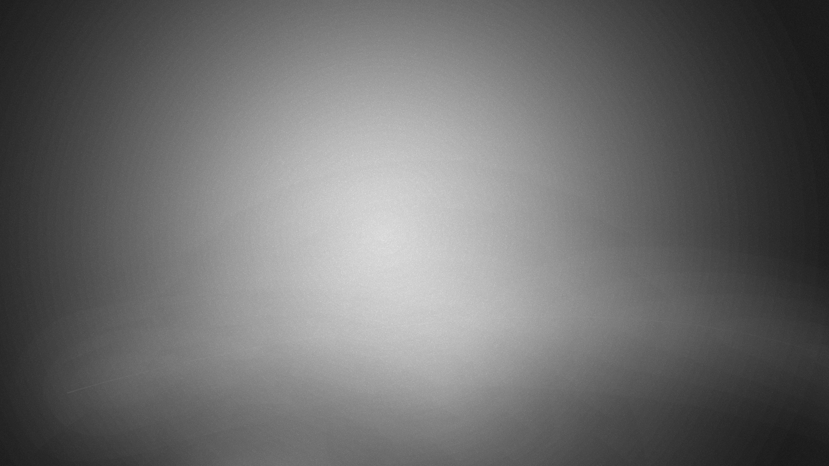
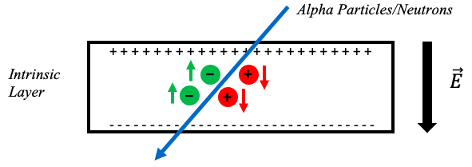
Using Semiconductors as Detectors
Detecting alpha particles and neutrons is hard due to their lack of an electrical charge
The detection of these particles is done through an interaction
Semiconductors have been notoriously used in radiation detection settings because they can carry out this interaction
They do so via the creation of electron-hole pairs

Slide 3
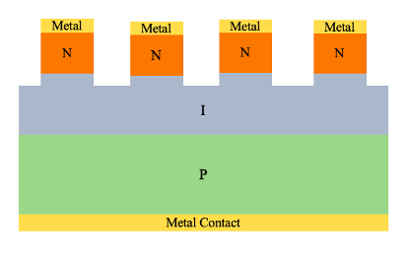
PIN Type Detectors
This specific structure allows us to carry out the interaction needed for detection
The N-layer is doped with phosphorus which has an “extra” electron
The P-layer is doped with boron which has a “missing” electron
The I-layer is the intrinsic diamond
The metal contacts consist of Ti, Ni, and Au
Lithography and etching is performed on the sample to create “mesas” and “valleys”

Slide 4

Why Cubic Boron Nitride (cBN)?
Second highest hardness and thermal conductivity with diamond being first
Wide bandgap of 6.3 eV compared to diamond (5.45 eV) and silicon (1.1 eV)
Great for high-temperature, radiation-filled environments
Diamond has already proven to be efficient at detecting alpha particles
cBN contains around 10.8 wt% of ${}_{ }^{10}B$, making it more efficient at detecting neutrons
We expect it to be quite insensitive to gamma radiation, which is not desired for our radiation testing

Slide 5
Fabrication Process
Clean: We clean the sample with a mixture of sulfuric acid and nitric acid.
Photoresist Layers: Using a CEE spinner we add 2 layers of photoresist with baking time in between.
Exposing to UV: Using the OAI808 aligner, we align our sample with a mask and expose it for about 4 seconds.
Develop: Using around 50 mL of developer (MIF300), we swirl our sample for around 40 seconds and then clean with DI water and dry with nitrogen.
Metal Deposition: Using the Lesker 3 we deposit metal contacts onto the n-side.
Lift-off: We heat up a small amount of stripper (AZ400T) to 150ºC and place our sample in the stripper for 15 minutes. Sample is then rinsed with DI water until the excess metal lifts off and the pattern is visible.
Metal Deposition: Using the Lesker 3 we deposit metal contacts onto the p-side.

Slide 6

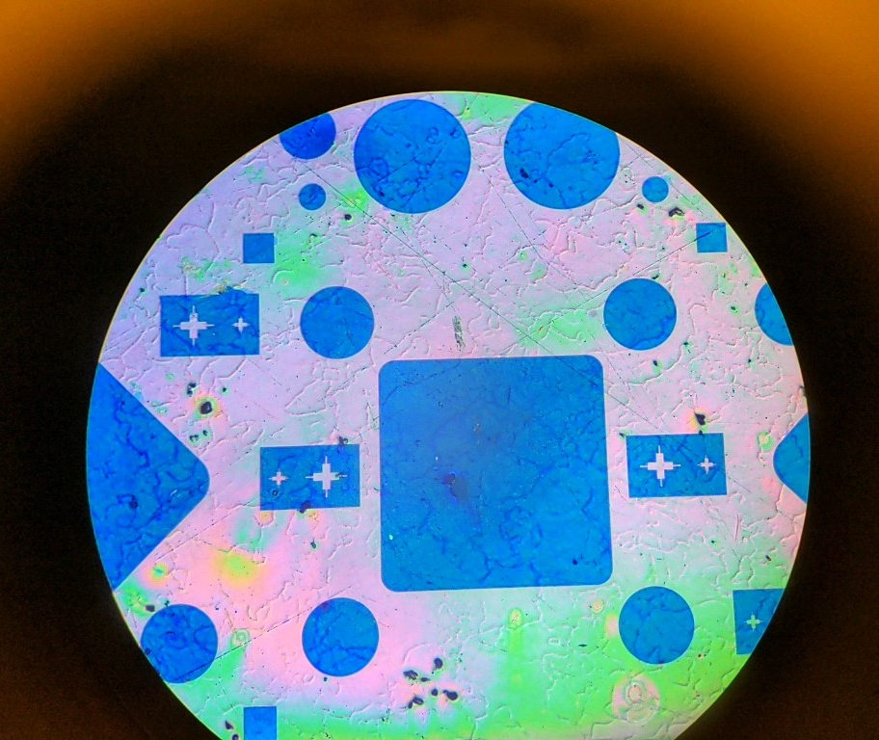
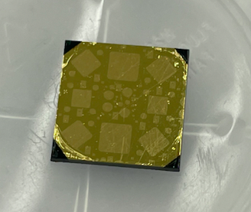


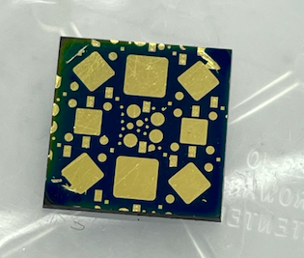
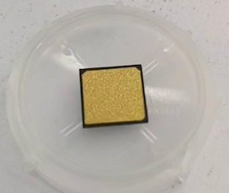


Slide 7

Radiation Testing
Electric Field
The Transient Current Technique (TCT) is used to carry out the testing.
Analysis of the current pulse shape.
Allows for the analysis of the electric field profile and its properties.
TCT can be employed for radiation detection, measuring charge-carrier velocity and mobility, electron and hole lifetimes as well as average effective space charge.
Position
$α$ particle source
P
Intrinsic
N
TCT Current
Time (ns)

Slide 8

Results
Some diodes showed ohmic behavior $\sim 4Ω$
Other diodes showed semi-ohmic or non-ohmic behavior with low current
Diode size did not appear to affect the IV behavior

Slide 9
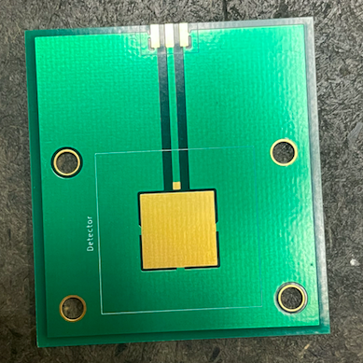
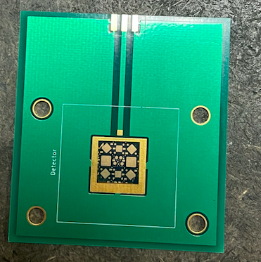

Next Steps
Working on radiation testing with $α$ particle injection
Mounted sample to a PCB board
Wire-bond the sample and the PCB board to create a proper circuit
Carry out radiation testing

Slide 10
Thank You!
Questions?

